Slide 1


Xcode Career Service
关注 Xcode 即可获得热腾腾的高频题解析视频、面试技巧及准备tips、北美IT就业咨询等干货
一对一实习或工作信息咨询服务
一对一面试能力评定 + 修改简历
一对一Mock interview强化训练服务

Slide 2
想进 xcode 的刷题群，请加老师微信 singerdmx， 他会拉你进群

Slide 3
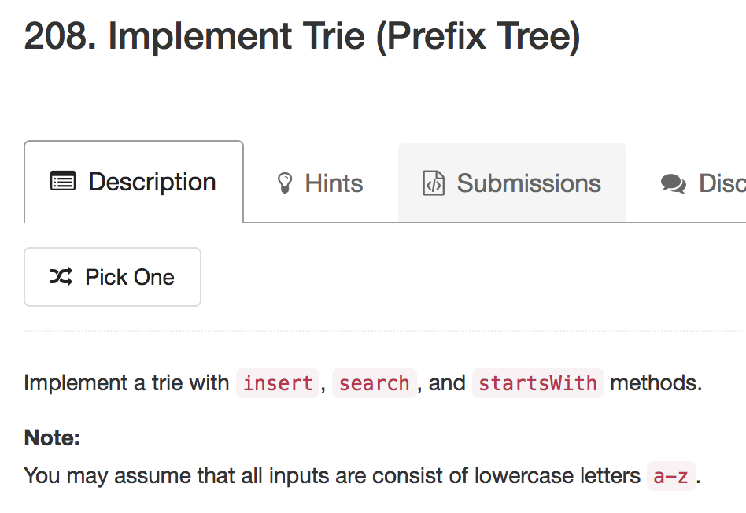
Mock
注意如何在 collabedit 上画 Trie 和表达 Trie

Slide 4
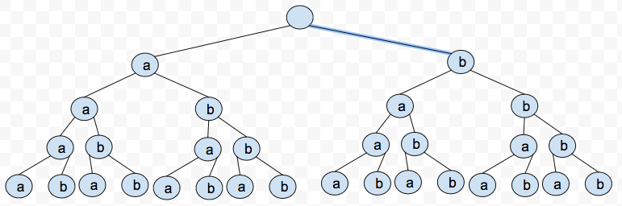
Trie / Prefix Tree 专题

Slide 5
Tries
Variable length keys
The decision on what path to follow is taken based on potion of the key
Static environment, fast retrieval but large space overhead
Applications:
dictionaries
text searching

Slide 6

@: word terminating symbol
@ boolean
@ pointer to word
every node contains pointers
to passing words

Slide 7
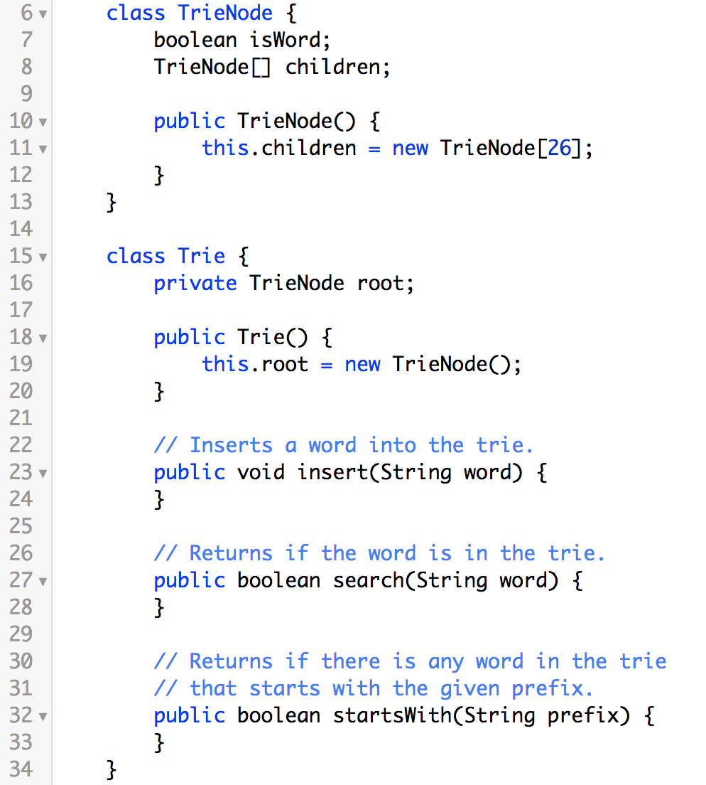
@ boolean

Slide 8
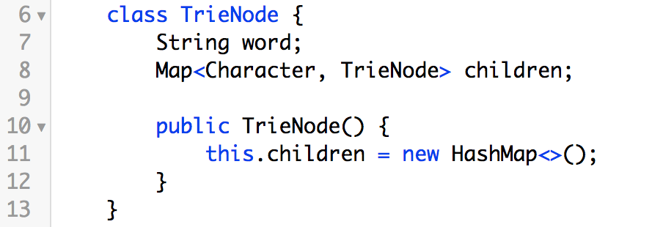
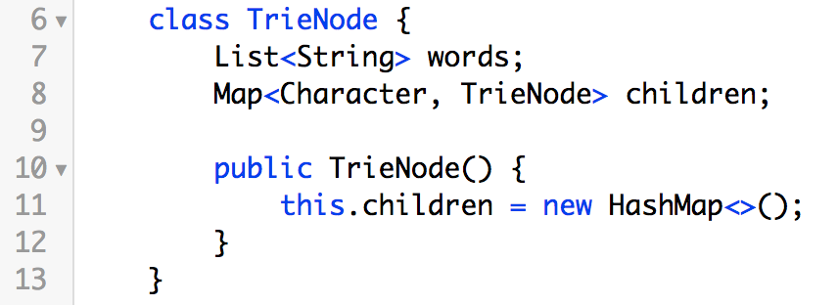
@ pointer to word
every node contains pointers
to passing words

Slide 9
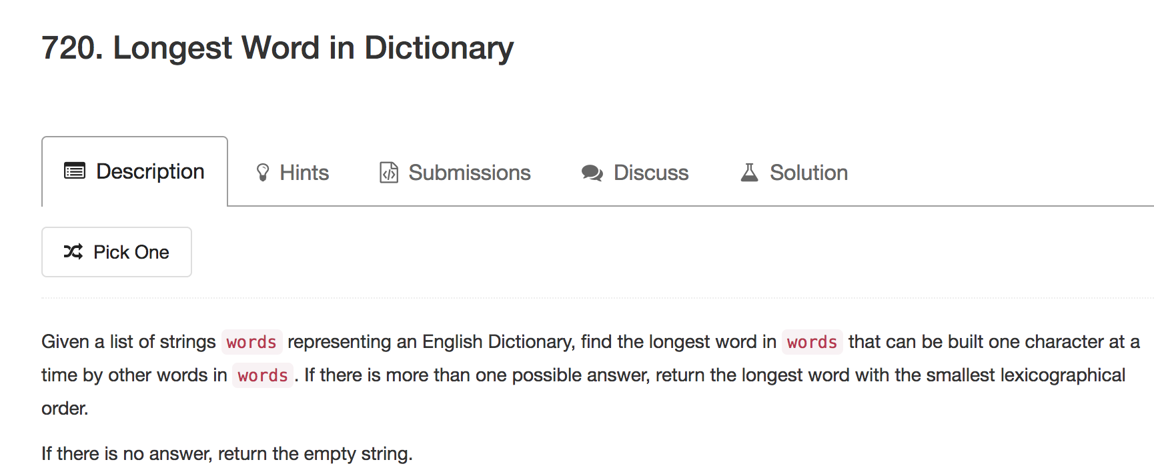

Slide 10
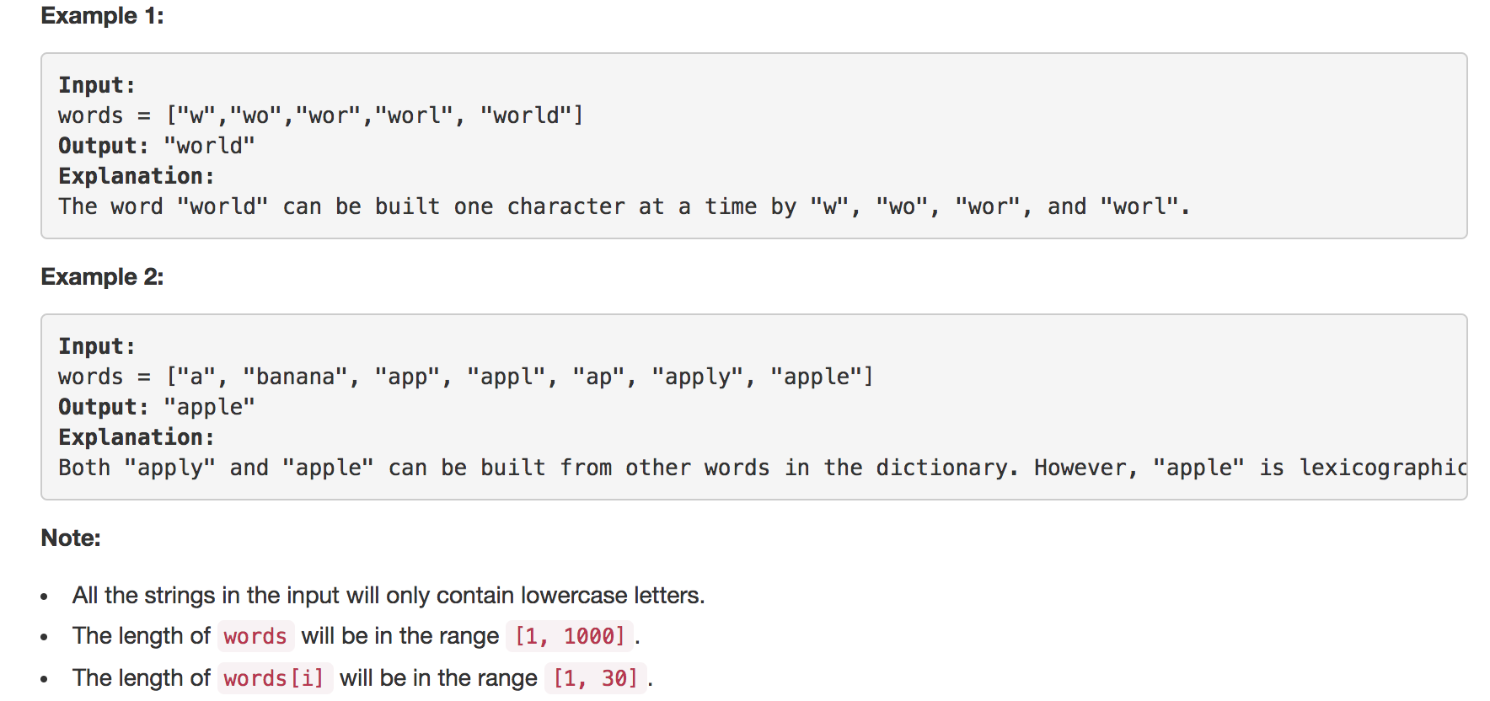

Slide 11
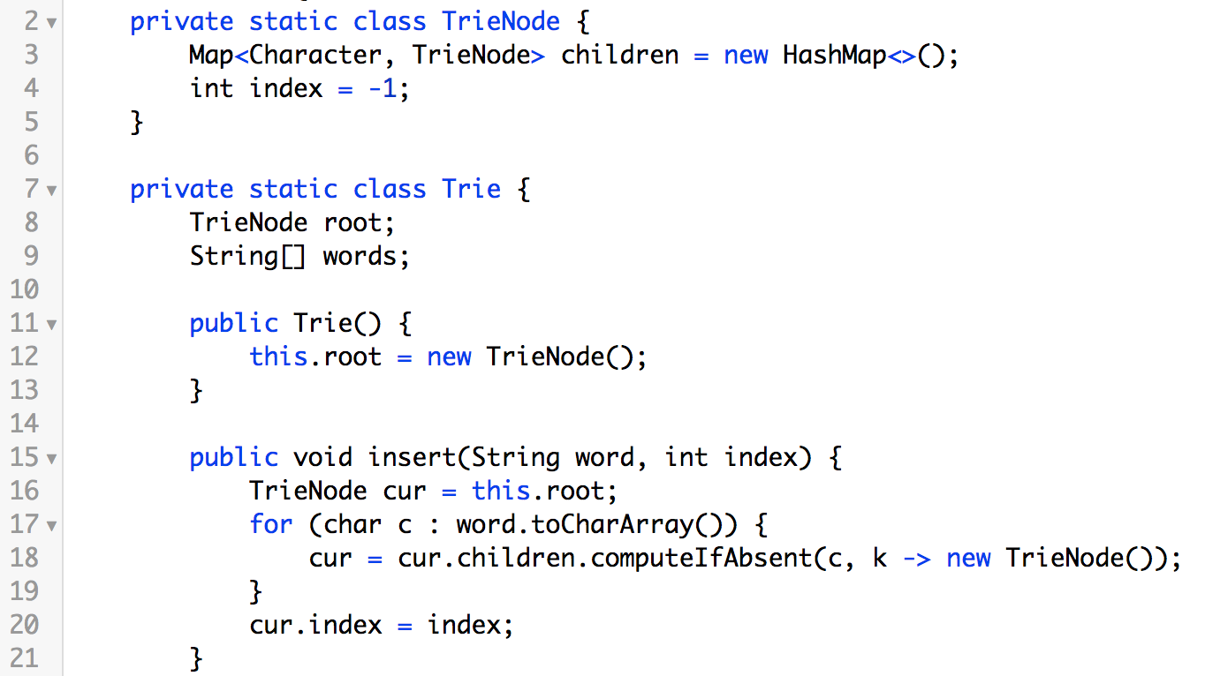
index saves space than pointer

Slide 12
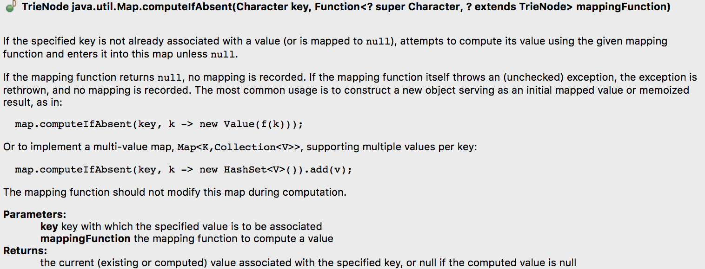

Slide 13
-1
a
0
b
-1
p
4
a
-1
p
2
n
-1
l
3
a
-1
y
e
n
-1
5
6
a
["a", "banana", "app", "appl", "ap", "apply", "apple"]
[ 0, 1, 2, 3, 4, 5, 6 ]
1

Slide 14
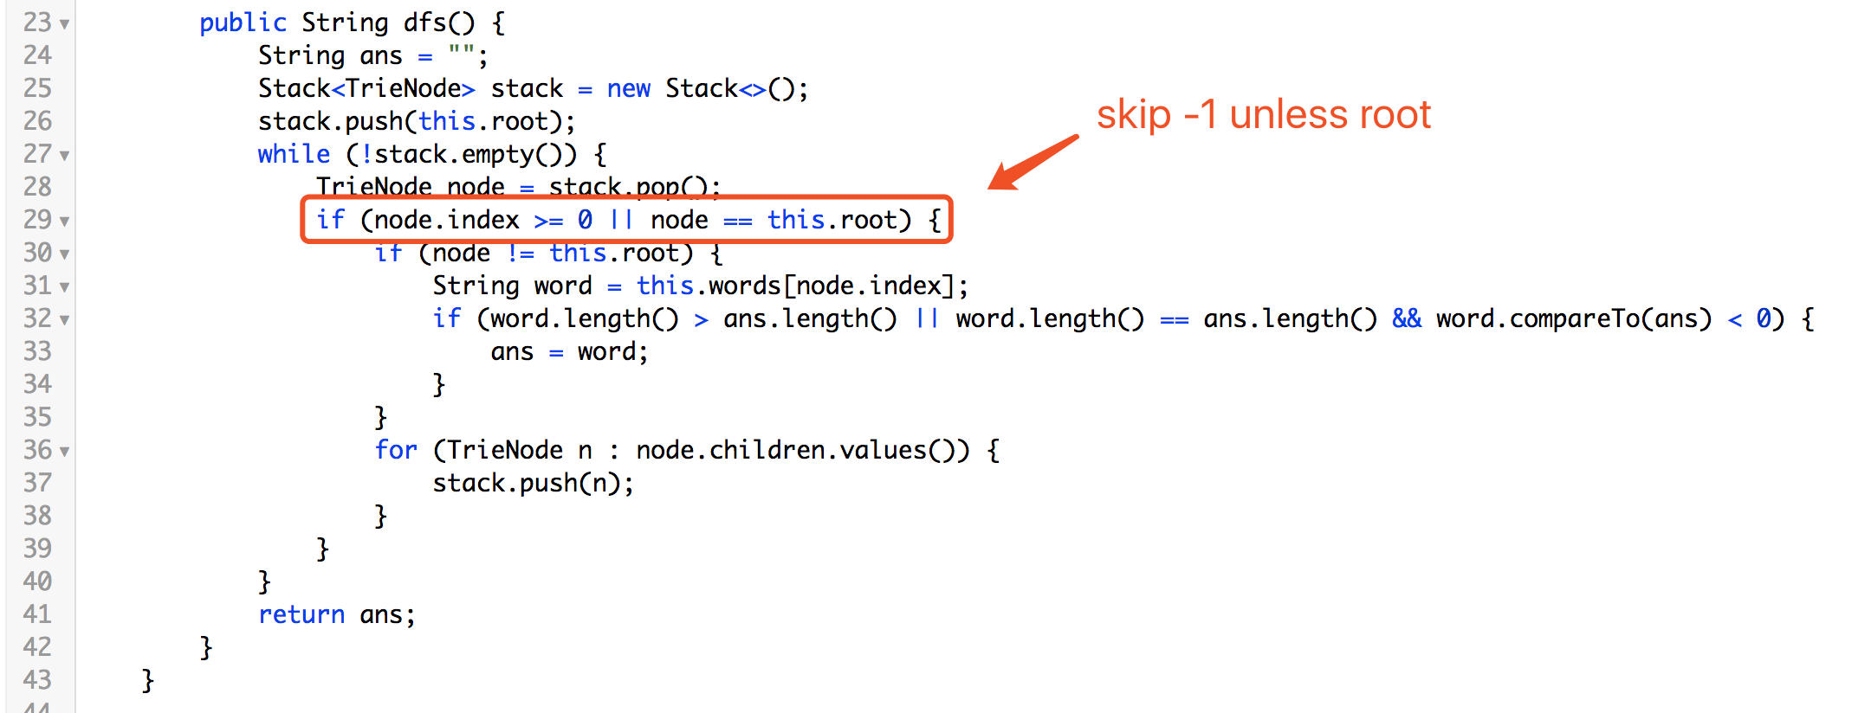

Slide 15
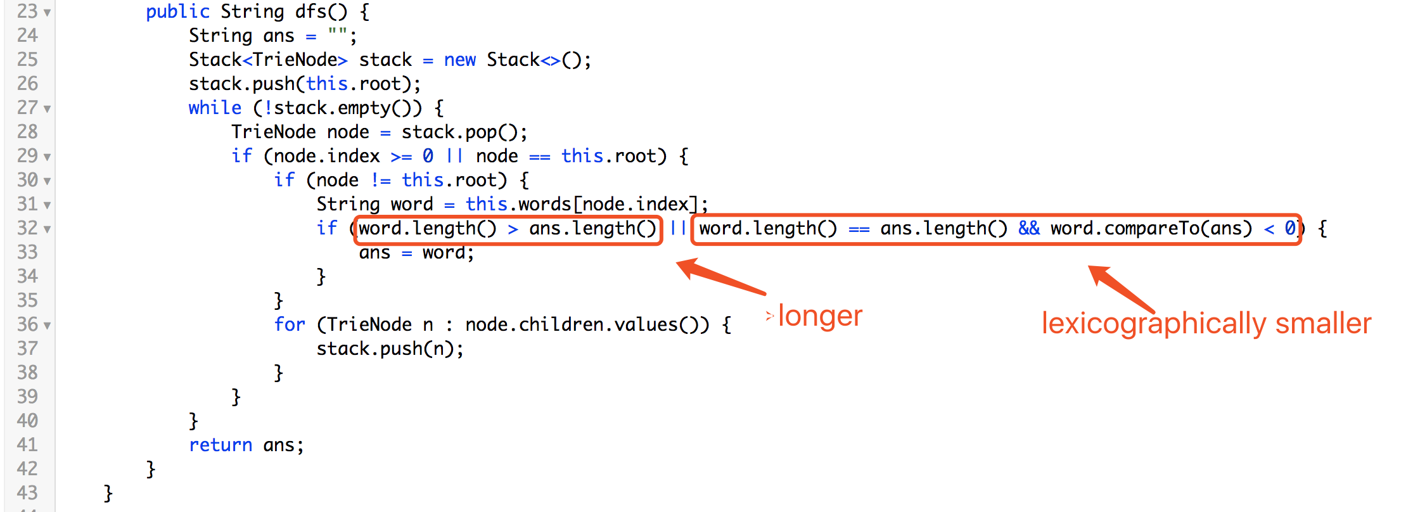

Slide 16
-1
node: root
Stack
(a, 0), (b, -1)
a
0
b
-1
p
4
a
-1
p
2
n
-1
l
3
a
-1
y
e
n
-1
5
6
a
1

Slide 17
-1
node: (a, 0)
Stack
(b, -1)
(p, 4)
a
0
b
-1
p
4
a
-1
p
2
n
-1
l
3
a
-1
y
e
n
-1
5
6
a
1

Slide 18
-1
node: (p, 4)
Stack
(b, -1)
(p, 2)
a
0
b
-1
p
4
a
-1
p
2
n
-1
l
3
a
-1
y
e
n
-1
5
6
a
1

Slide 19
-1
node: (p, 2)
Stack
(b, -1)
(l, 3)
a
0
b
-1
p
4
a
-1
p
2
n
-1
l
3
a
-1
y
e
n
-1
5
6
a
1

Slide 20
-1
node: (l, 3)
Stack
(b, -1)
(y, 5), (e, 6)
a
0
b
-1
p
4
a
-1
p
2
n
-1
l
3
a
-1
y
e
n
-1
5
6
a
1

Slide 21
-1
node: (y, 5)
Stack
(b, -1)
(e, 6)
a
0
b
-1
p
4
a
-1
p
2
n
-1
l
3
a
-1
y
e
n
-1
5
6
a
1

Slide 22
-1
node: (e, 6)
Stack
(b, -1)
a
0
b
-1
p
4
a
-1
p
2
n
-1
l
3
a
-1
y
e
n
-1
5
6
a
1

Slide 23
-1
node: (b, -1)
a
0
b
-1
p
4
a
-1
p
2
n
-1
l
3
a
-1
y
e
n
-1
5
6
a
1

Slide 24

Facebook 经典难题

Slide 25
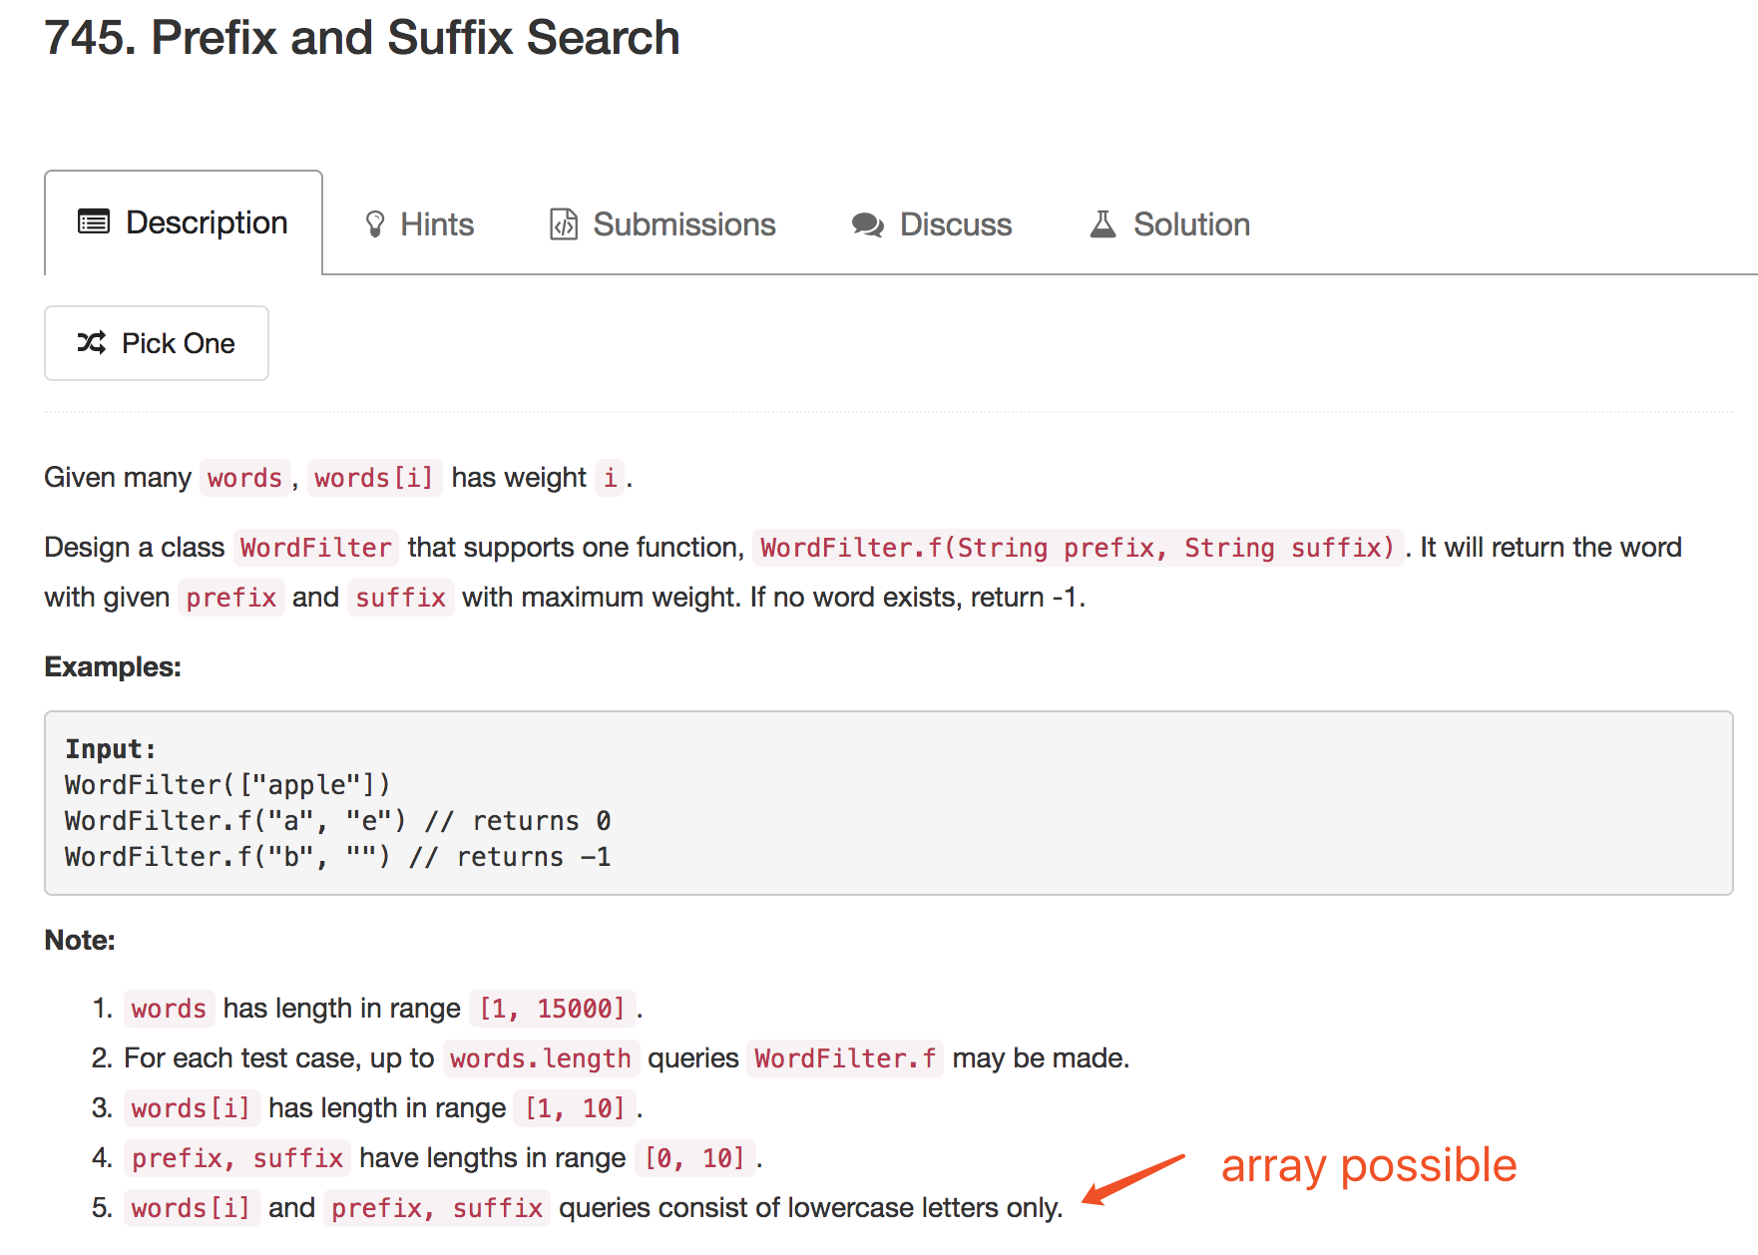

Slide 26
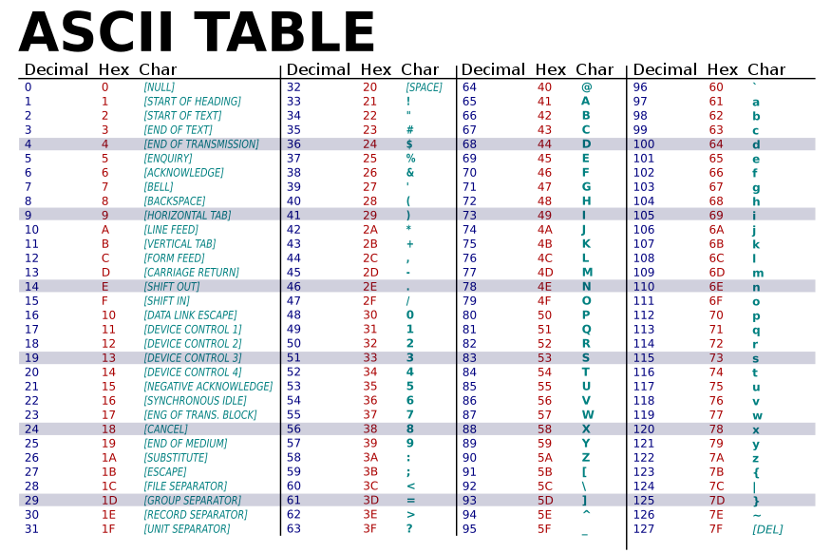

Slide 27
Hash Code of Prefix/Suffix Character
Char | Hash Code
` (no existence) | 0
a | 1
b | 2
… | …
y | 25
z | 26

Slide 28
Hash Code of Prefix/Suffix Character
Hash Code | PrefixChar | SuffixChar
0 | ` | #
1 | ` | a
2 | ` | b
… | … | …
25 | ` | y
26 | ` | z

Slide 29
Hash Code of Prefix/Suffix Character
Hash Code | PrefixChar | SuffixChar
0 | ` | `
27 | a | `
28 (27 + 1) | a | a
29 (27 + 2) | a | b
… | … | …
52 (27 + 25) | a | y
53 (27 + 26) | a | z

Slide 30
Hash Code of Prefix/Suffix Character
Hash Code | PrefixChar | SuffixChar
0 | ` | `
54 (2 * 27) | b | `
55 (2 * 27 + 1) | b | a
56 (2 * 27 + 2) | b | b
… | … | …
79 (2 * 27 + 25) | b | y
80 (2 * 27 + 26) | b | z

Slide 31
Hash Code of Prefix/Suffix Character
Hash Code | PrefixChar | SuffixChar
0 | ` | `
702 (26 * 27) | z | `
703 (26 * 27 + 1) | z | a
704 (26 * 27 + 2) | z | b
… | … | …
727 (26 * 27 + 25) | z | y
728 (26 * 27 + 26) | z | z

Slide 32
Hash Code of Prefix/Suffix Character
``: 0 | a`: 27 | b`: 54 | c`: 81 | d`: 108 | x`: 648 | y`: 675 | z`: 702
`a: 1 | aa: 28 | ba: 55 | ca: 82 | da: 109 | xa: 649 | ya: 676 | za: 703
`b: 2 | ab: 29 | bb: 56 | cb: 83 | db: 110 | xb: 650 | yb: 677 | zb: 704
`c: 3 | ac: 30 | bc: 57 | cc: 84 | dc: 111 | xc: 651 | yc: 678 | zc: 705
`d: 4 | ad: 31 | bd: 58 | cd: 85 | dd: 112 | xd: 652 | yd: 679 | zd: 706
`x: 24 | ax: 51 | bx: 78 | cx: 105 | dx: 132 | xx: 672 | yx: 699 | zx: 726
`y: 25 | ay: 52 | by: 79 | cy: 106 | dy: 133 | xy: 673 | yy: 700 | zy: 727
`z: 26 | az: 53 | bz: 80 | cz: 107 | dz: 134 | xz: 674 | yz: 701 | zz: 728

Slide 33
Hash Code of Prefix/Suffix Character
public int getHashCode(char prefixChar, char suffixChar) {
return (prefixChar - '`') * 27 + (suffixChar - '`');
}

Slide 34
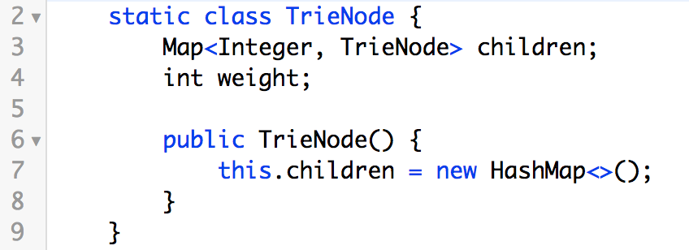
a | p | p | l | e
27
5
32
prefix
suffix
a*
a*e
*e
Only suffix: `e (5)
Only prefix: a` (1)
prefix + suffix: ae
(27 * 1 + 5 = 32)

Slide 35
a | p | p | l | e
27
5
32
prefix
a*
*e
a*e
Only prefix: p`
(16 * 27 = 432)
16 * 27
ap*

Slide 36
a | p | p | l | e
27
5
32
prefix
a*
a*e
*e
Only prefix: p`
(16 * 27 = 432)
16 * 27
ap*
16 * 27
app*

Slide 37
a | p | p | l | e
27
5
32
prefix
a*
*e
a*e
Only prefix: l`
(12 * 27 = 324)
16 * 27
ap*
16 * 27
app*
12 * 27
appl*

Slide 38
a | p | p | l | e
27
5
32
prefix
a*
*e
a*e
Only prefix: e`
(5 * 27 = 135)
16 * 27
ap*
16 * 27
app*
12 * 27
appl*
5 * 27
apple

Slide 39
a | p | p | l | e
27
5
32
suffix
a*
a*e
*e
12
Only suffix: `l (12)
16 * 27
ap*
*le
16 * 27
app*
12 * 27
appl*
5 * 27
apple

Slide 40
a | p | p | l | e
27
5
32
suffix
a*
*e
a*e
12
Only suffix: `p (16)
16 * 27
ap*
*le
16 * 27
app*
16
*ple
12 * 27
appl*
5 * 27
apple

Slide 41
a | p | p | l | e
27
5
32
suffix
a*
*e
a*e
12
Only suffix: `p (16)
16 * 27
ap*
*le
16 * 27
app*
16
*ple
16
12 * 27
appl*
*pple
5 * 27
apple

Slide 42
a | p | p | l | e
27
5
32
suffix
a*
*e
a*e
12
Only suffix: `a (1)
16 * 27
ap*
*le
16 * 27
app*
16
*ple
16
12 * 27
appl*
*pple
5 * 27
apple
1
apple

Slide 43
a | p | p | l | e
prefix + suffix: ae
(27 * 1 + 5 = 32)
1
5
32
prefix
suffix
a*
*e
a*e
ap*e
a*le
ap*le
Only prefix
Only suffix
prefix + suffix

Slide 44
a | p | p | l | e
prefix + suffix: ae
(27 * 1 + 5 = 32)
1
5
32
prefix
suffix
a*
*e
a*e
ap*e
a*le
ap*le
Only prefix
Only suffix
prefix + suffix
pl (444)
app*e
a*ple
apple
apple

Slide 45
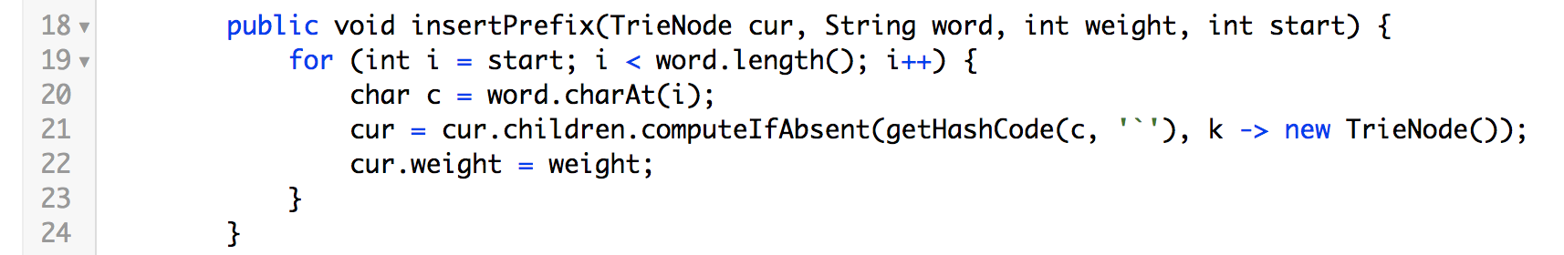
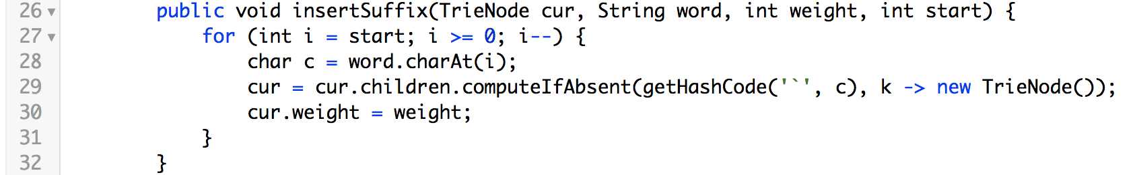

Slide 46
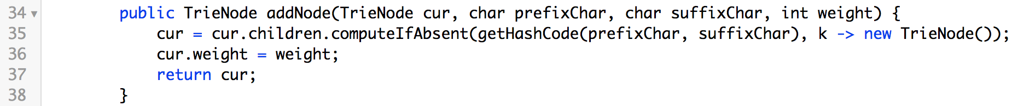
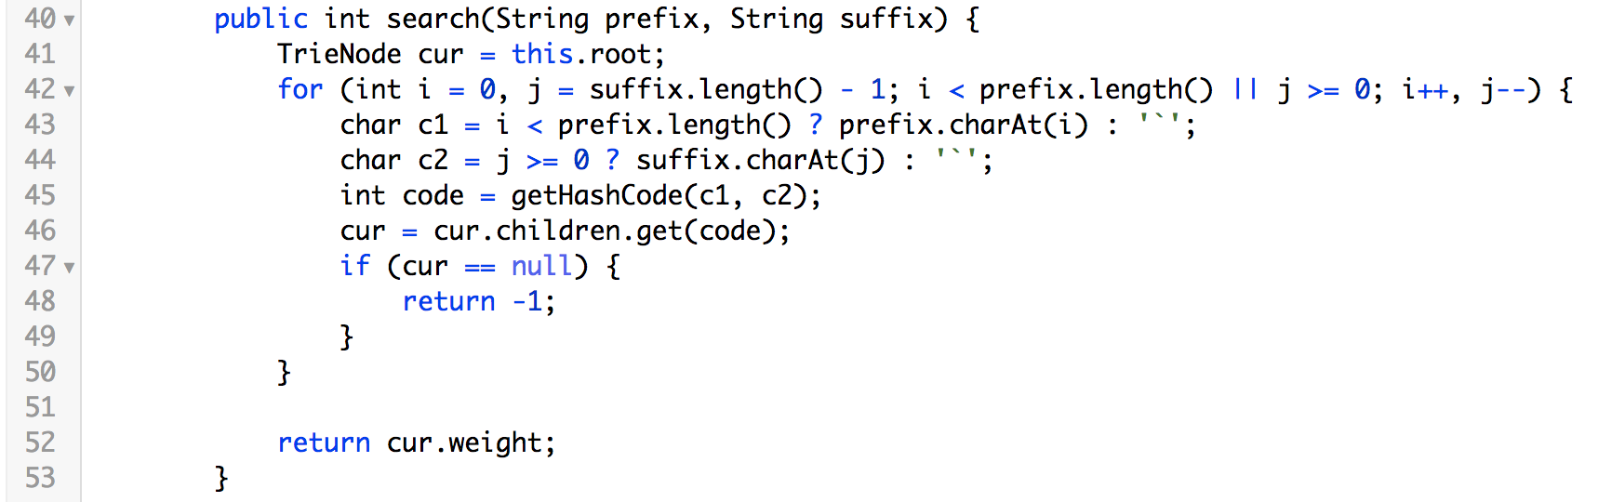

Slide 47
Xcode Career Service
有任何问题，请咨询 xc0d3@outlook.com

